Slide 1
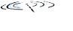






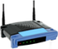



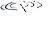
CSC358: Principles of Computer Networks
Lecture 5 – Part 1: Ethernet
mobile network
4G
national or global ISP
Streaming
video
Skype
IP
local or regional ISP
home network
content
provider
network
HTTP
datacenter
network
Ethernet
TCP
enterprise
network
Erfan Meskar
Winter 2025, University of Toronto, Mississauga

Slide 2
So Far …
So far:
We built our first small network. How?
By allowing users to share the link
We studied different MAC approaches
We studied CSMA/CD in detail
Now:
We will study a real networking technology that used CSMA/CD.
10BASE5: Original Ethernet (over coaxial cable) used CSMA/CD.

Slide 3

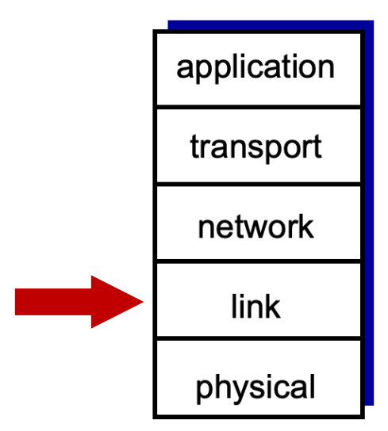
Outline
Case Study of CSMA/CD: Ethernet

Slide 4
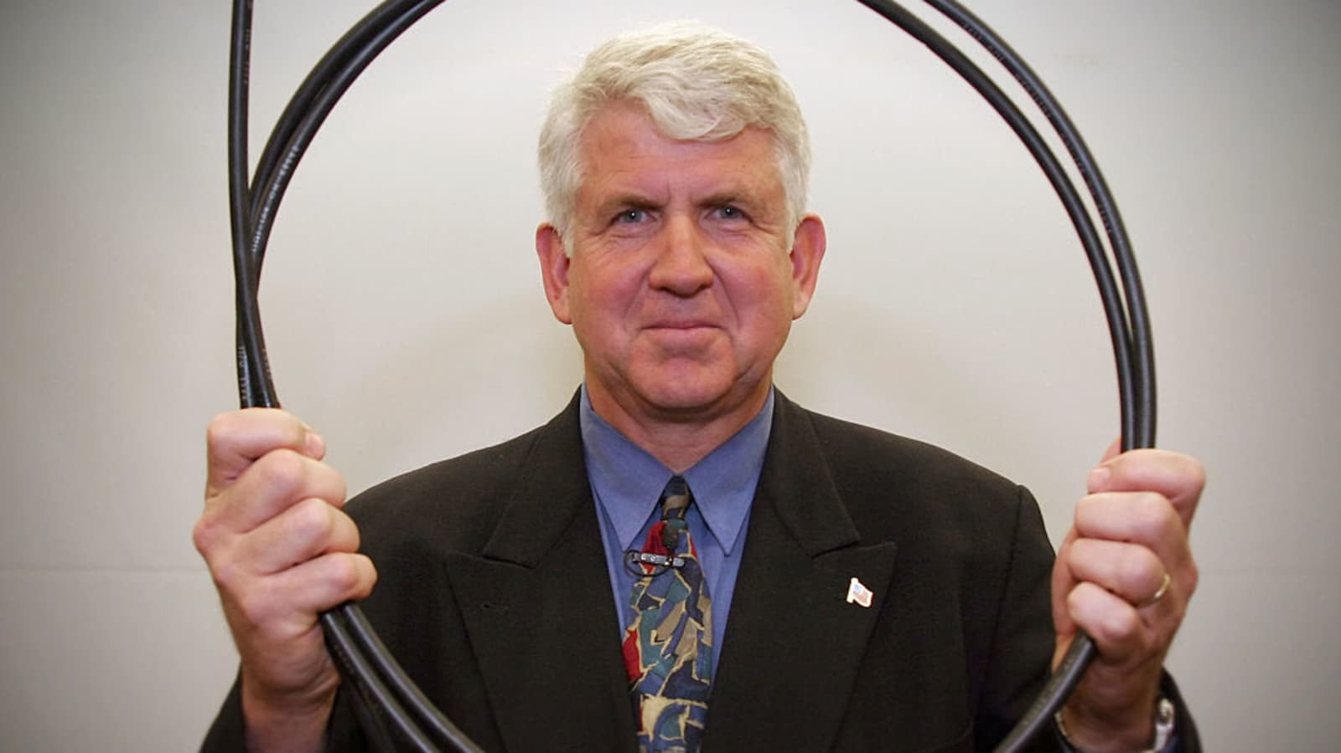
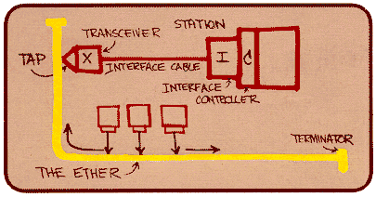
Ethernet
It is the first and by far the most widely used wired LAN technology.
The elegant design principles of Ethernet allowed it to scale well while maintaining compatibility and efficiency:
from 10 Mbps (coaxial)
to 100 Gbps+ (fiber and twisted pair)
The Ethernet frame structure (IEEE 802.3) has remained consistent since the original version.
Robert Metcalfe
Metcalfe’s Ethernet sketch

Slide 5
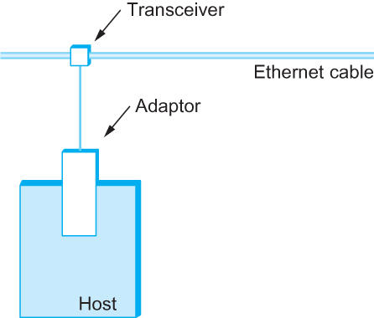
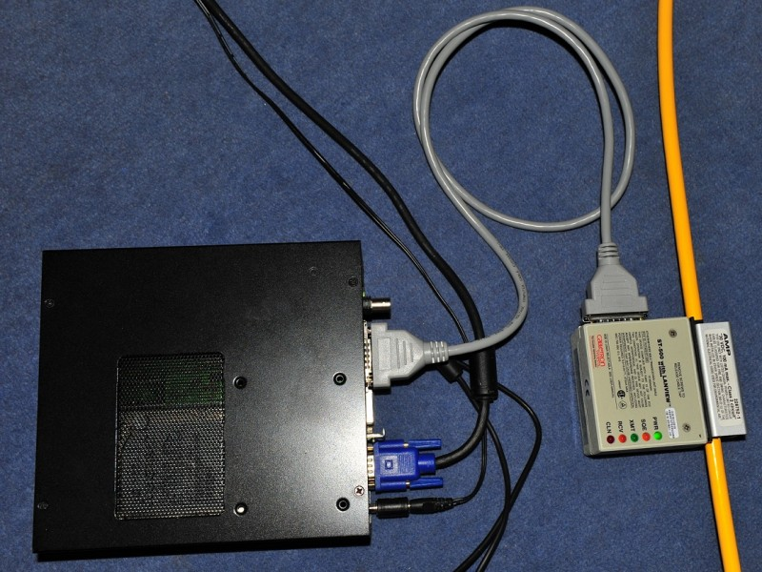
Original Ethernet: 10BASE5 ("ThickNet")
Original Ethernet segment was implemented on a coaxial cable of up to 500 m
Hosts connect to the segment by tapping into it
A transceiver is used to
Detect when the line is idle
Drive signal when the host is transmitting
Receive incoming signal
The transceiver is connected to an Ethernet adaptor which is plugged into the host.
Ethernet transceiver and adaptor

Slide 6
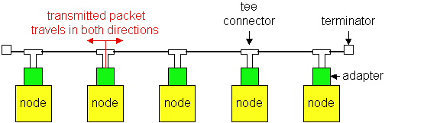
Ethernet
Ethernet was invented as a broadcast technology
Hosts shared channel, i.e., each packet received by all attached hosts.
It used CSMA/CD for media access control.
Up until 10BASE-T (Twisted Pair), Ethernet used Manchester encoding.

Slide 7
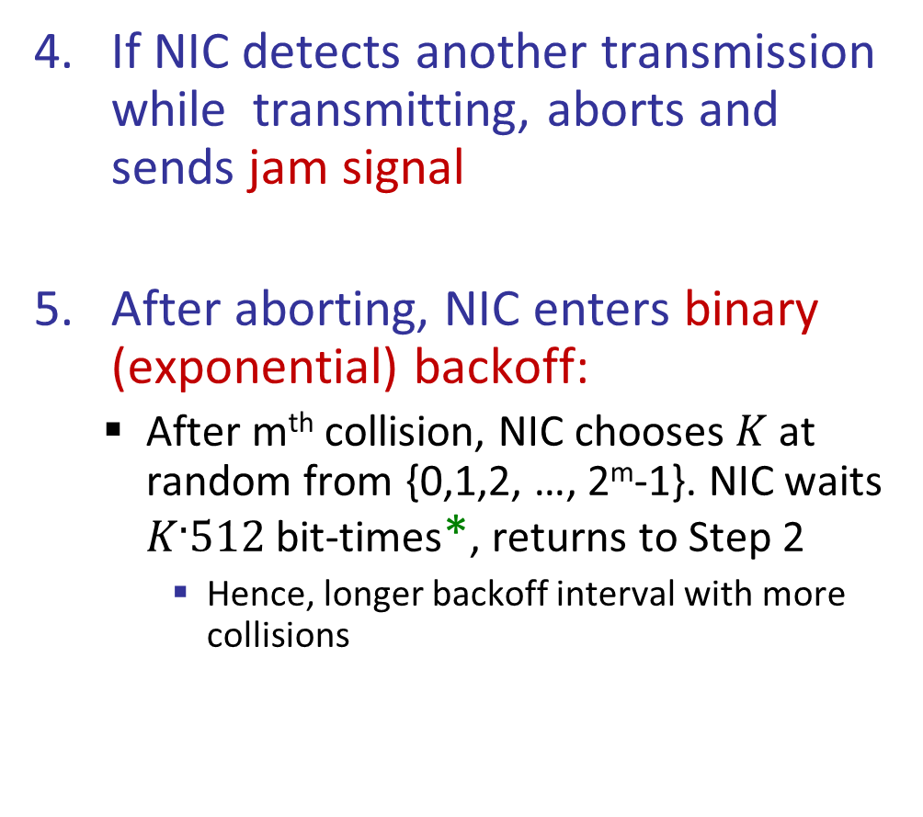
Ethernet’s Media Access Control Algorithm
NIC receives datagram from network layer, creates frame
If NIC senses channel idle, starts frame transmission. Otherwise, waits until channel idle, then transmits.
If NIC transmits entire frame without detecting another transmission, it is done with frame!
If NIC detects another transmission while transmitting, aborts and sends jam signal
After aborting, NIC enters binary (exponential) backoff:
After m^{th} collision, NIC chooses $K$ at random from {0,1,2, …, 2^{m}-1}. NIC waits $K·512$ bit-times*, returns to Step 2
Hence, longer backoff interval with more collisions
* One bit time is equal to 1/(bandwidth) second.

Slide 8
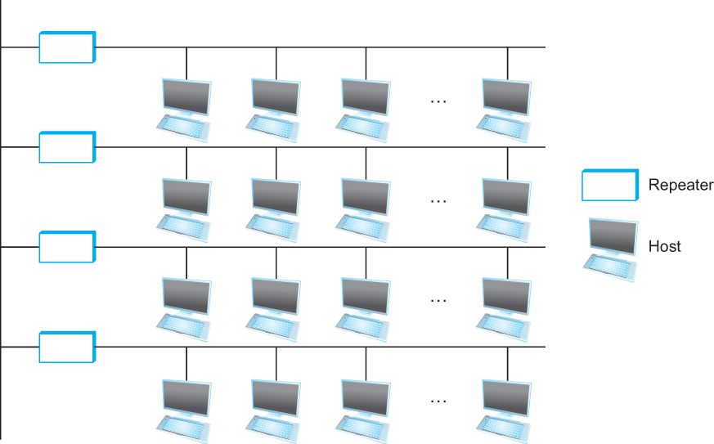
Geographical Span of 10BASE5 Ethernet
Multiple Ethernet segments can be joined together by repeaters
A repeater is a device that forwards digital signals
More details on repeaters in the next part
No more than four repeaters may be positioned between any pair of hosts.
An Ethernet has a total reach of only 2500 m.
Ethernet repeater

Slide 9
Access Protocol for Ethernet
The protocol is commonly called Ethernet’s Media Access Control (MAC) protocol.
It is implemented in Hardware on the network adaptor.
Frame format:
1st bit on wire
46 - 1500
Bytes:
7
1
6
6
2
0 - 1500
0 - 46
4
CRC
Pad
Data
Type
SA
DA
SFD
Preamble

Slide 10
Ethernet Frame Format, cont’d
46-1500
Bytes:
7
1
6
6
2
0-1500
0-46
4
CRC
Pad
Data
Type
SA
DA
SFD
Preamble
Preamble (7 byte 101010 101010 …): trains clock-recovery circuits
Start of Frame Delimiter (10101011): indicates start of frame
Type: Indicates protocol of encapsulated data (e.g., IPv4 = 0x0800)
Pad: Zeroes used to ensure minimum frame length.
Excluding the preamble and SFD, the minimum frame size is 64 byte, and the maximum frame size is 1518 Bytes.
Cyclic Redundancy Check: check sequence to detect bit errors.

Slide 11
Ethernet Frame Format
46-1500
Bytes:
7
1
6
6
2
0-1500
0-46
4
CRC
Pad
Data
Type
SA
DA
SFD
Preamble
Source MAC Address (6 byte) and Destination MAC Address (6 byte):
Each MAC address is a 48-bit globally unique address, assigned by manufacturer.
We show MAC address as six groups of two hexadecimal digits separated by colons
e.g.: 1A:2B:3D:4E:5F:60
Adaptor passes frame to network-level protocol if:
The destination address matches the adaptor’s
Or the destination address is all 1s (i.e., FF:FF:FF:FF:FF:FF) which is the broadcast address
Or the destination address starts with 1 but its not broadcast, it is called multicast
A host can program its adaptor to accept some set of multicast addresses.
Otherwise, adapter discards frame

Slide 12
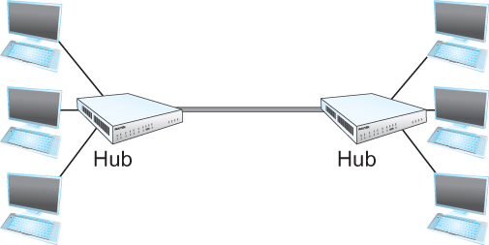
Ethernet Evolution
Early 1980s: 10Mbps shared thick coax
Late 1980s: 10BaseT
T stands for twisted pair
Limited to 100 m in length
the common configuration is to have several point-to-point segments coming out of a multiway repeater, called Hub
Ethernet Hub

Slide 13
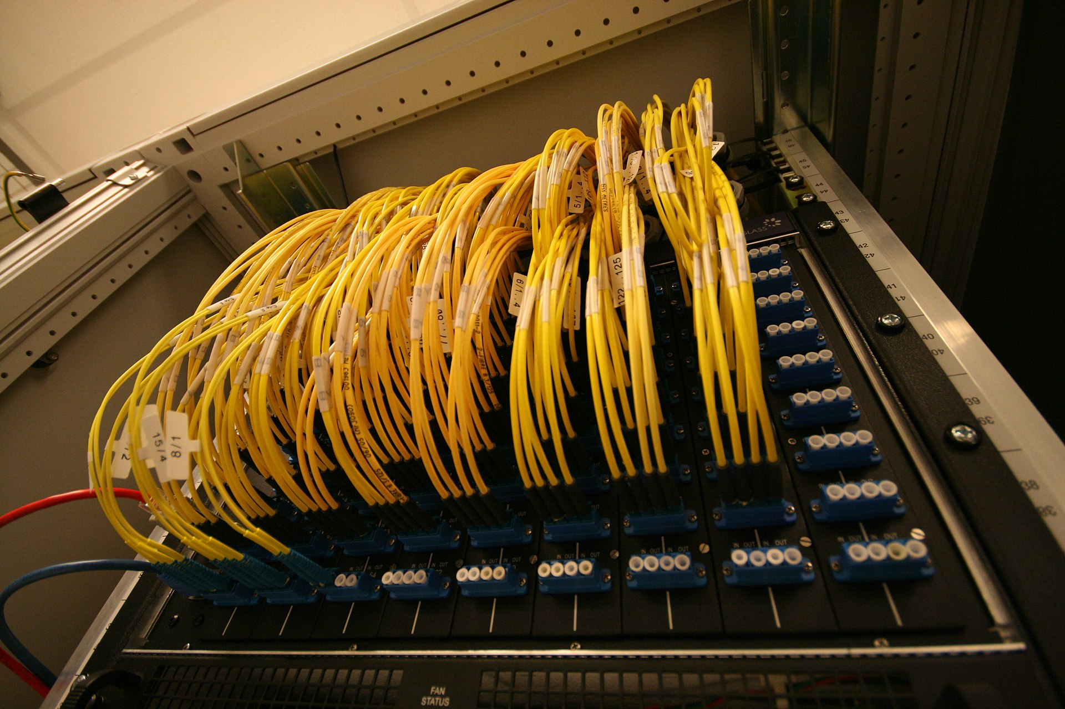
Ethernet Evolution
Early 1990s: Ethernet Switches.
A cable connects the switch to the host.
Fullduplex. No collision!
Since then: 100Mb/s Ethernet, 1GE, 10GE, 100GE, 400GE

Slide 14
Next Time
Switched Ethernet
switch/bridge
Switch learns how to reach A.
B
hub
hub
hub
A
C
collision domain
collision domain
D
collision domain

